Slide 1
Understanding and Testing Blockchain
SOFTWARE QUALITY CONFERENCE
PACIFIC NW
John Cvetko 10.15.2019
PNSQC ™

Slide 2
Overview
SOFTWARE QUALITY CONFERENCE
PACIFIC NW
Background
Blockchain Networks
Consensus models
Network types
Applications
When does it make sense?
Technology and Testing lifecycle
PNSQC ™

Slide 3
Background
The most well known blockchain application is Bitcoin
Built to operate in the most hostile of environments
Designed to be trust (security) mechanism for untrusted parties
Blockchain is appealing to business and governments
Provides an immutable ledger
Transparency
Security
Remove middlemen that historically, have provided trust for two parties
Increase costs
Potential a security vulnerability

Slide 4
Background
Blockchain hurdles for biz and gov entities
Speed
Transactions can take hours or days to complete
Lack of formal standards
Opensource standards are being developed – Hyperledger consortium
Flexibility
Crypto models are purpose built – biz and gov applications will require more flexibility
Cost and Risk
It’s new and still unproven in business environments
It’s not mainstream – proprietary methods

Slide 5
Characteristics
A blockchain platform has the following key characteristics:
Decentralized:
Implemented in a peer-to-peer configuration
Immutability:
No participant can tamper with a transaction after it has been recorded to the ledger without being detected.
Consensus:
For a block (data) to be appended to the chain, all participants must agree on its validity.
Transparency:
A single, shared ledger provides one place to go to determine the ownership of an asset or the completion of a transaction.

Slide 6
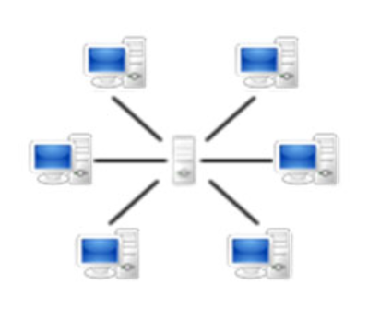
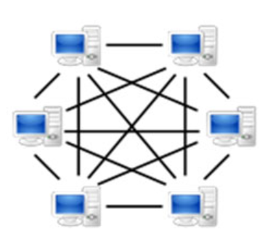
Centralized v. Decentralized
SOFTWARE QUALITY CONFERENCE
PACIFIC NW
Decentralized or Peer-to-Peer
System reliability
Scale and bandwidth
Harder to disrupt, e.g, DDoS, hack, etc.
Centralized
Faster
Consistent
Efficient
Cost
PNSQC ™
Notes:
Centralized:
Faster – less consensus required, a singe system writes to the DB
Consistent – the system can be easily patched upgraded, uniformed configuration, etc.
Efficient – less personnel required to support, less power, space, network equipment,
Cost – less hardware, software, personnel
Decentralized or P2P:
System reliability – one node goes out the system can still operate
Scale – to increase capacity more nodes can be added
Bandwidth – A single nodes doesn’t determine the capacity of the network
Harder to disrupt, e.g, DDoS, hack, etc. – a DDOS attack would have to target every node. A single compromised system can be identified and ignored by the other nodes in the network

Slide 7
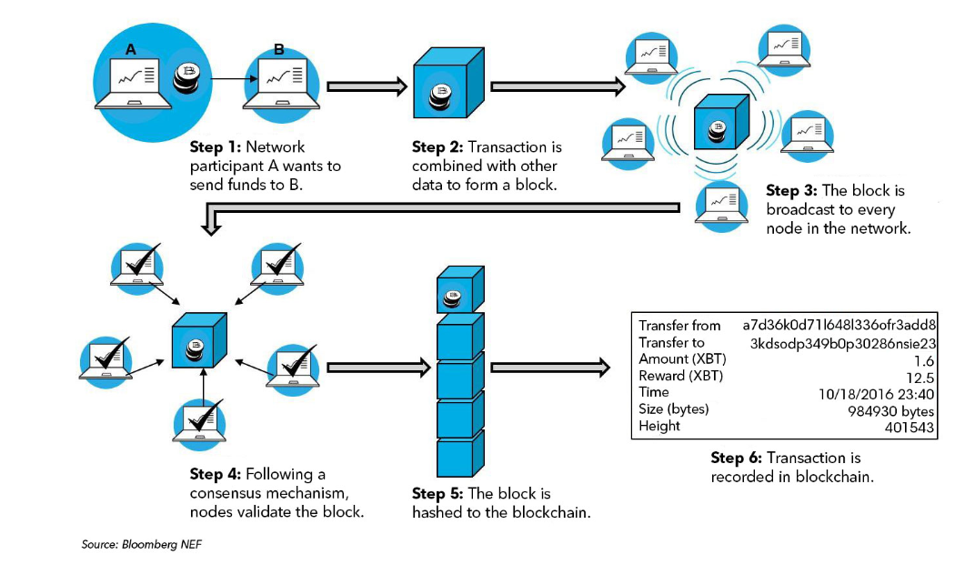
General Blockchain Process
SOFTWARE QUALITY CONFERENCE
PACIFIC NW
PNSQC ™

Slide 8
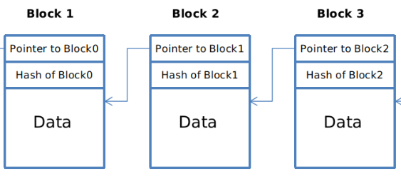
The Block and Chain
SOFTWARE QUALITY CONFERENCE
PACIFIC NW
Blocks contain
Data and meta-data
A block of data consists of a number transactions
Time and sequence of transactions
Previous blocks hash value
It’s unique hash value
Chain
When a new block is validated, it is committed to the chain
The block linkage is made through the new block containing the previous blocks hash value acting as a pointer
If a transaction is in error, a new transaction must be used to reverse the error, and both transactions are then visible.
PNSQC ™

Slide 9
Block Data Types
SOFTWARE QUALITY CONFERENCE
PACIFIC NW
Transaction Data
Asset record, contracts, item provenance, identity, etc.
Chaincode a.k.a Smart Contract
System chaincode – used to manage the network. For example, policy for admitting new nodes to the network
Application chaincode – (core component)
It is used to execute business logic when a specific condition is valid. For example, if it detects a specific stock price a sell option is executed
Contract 1
License
Identity 2
Identity 1
Contract 2
Chaincode
PNSQC ™

Slide 10
Consensus Protocols
SOFTWARE QUALITY CONFERENCE
PACIFIC NW
Consensus protocols are key to blockchain technology
Their primary purpose is to determine potential bad actors in the network, i.e., to establish and maintain trust in the network
Consensus protocols dictate how the network nodes validate the blocks to be appended to the chain
There are a dozen or so models that each focus on a different deployment requirements
PNSQC ™
Notes:
Proof of Work (POW)
The network has a standing problem that each node tries to solve. The First node to solve a specific problem wins the right to append the block to the network. Given the cost to implement this model there is a bounty placed on solving the puzzle first.
Proof of Elapsed Time (PoET)
First one to wake up wins. This method was developed by intel and is focused on scalability and speed.
Proof of Authority (PoA)
A set number of nodes in the network are used as validation nodes. If majority of the authorized nodes agree the block is deemed valid. If a validator node determines the blocks validity is different then the majority. That node looses standing.
Practical Byzantine Fault Tolerance (PBFT)
Nodes vote on the block validity, if 2 two thirds agree then it’s considered valid.
This model assumes that at anyone time nodes in the system are compromised. It’s considered lower in latency and still very secure

Slide 11
Consensus Protocols
SOFTWARE QUALITY CONFERENCE
PACIFIC NW
Few of the models
Proof of Work (POW)
First node to solve a specific problem wins.
Proof of Elapsed Time (PoET)
First one to wake up wins - considered a “lottery” scheme
Proof of Authority (PoA)
Requires a majority of “authorized” nodes to agree on the block validity
Practical Byzantine Fault Tolerance (PBFT)
Nodes vote on the block validity, if two thirds agree then it’s considered valid.
PNSQC ™
Notes:
Proof of Work (POW)
The network has a standing problem that each node tries to solve. The First node to solve a specific problem wins the right to append the block to the network. Given the cost to implement this model there is a bounty placed on solving the puzzle first.
Proof of Elapsed Time (PoET)
First one to wake up wins. This method was developed by intel and is focused on scalability and speed.
Proof of Authority (PoA)
A set number of nodes in the network are used as validation nodes. If majority of the authorized nodes agree the block is deemed valid. If a validator node determines the blocks validity is different then the majority. That node looses standing.
Practical Byzantine Fault Tolerance (PBFT)
Nodes vote on the block validity, if 2 two thirds agree then it’s considered valid.
This model assumes that at anyone time nodes in the system are compromised. It’s considered lower in latency and still very secure

Slide 12
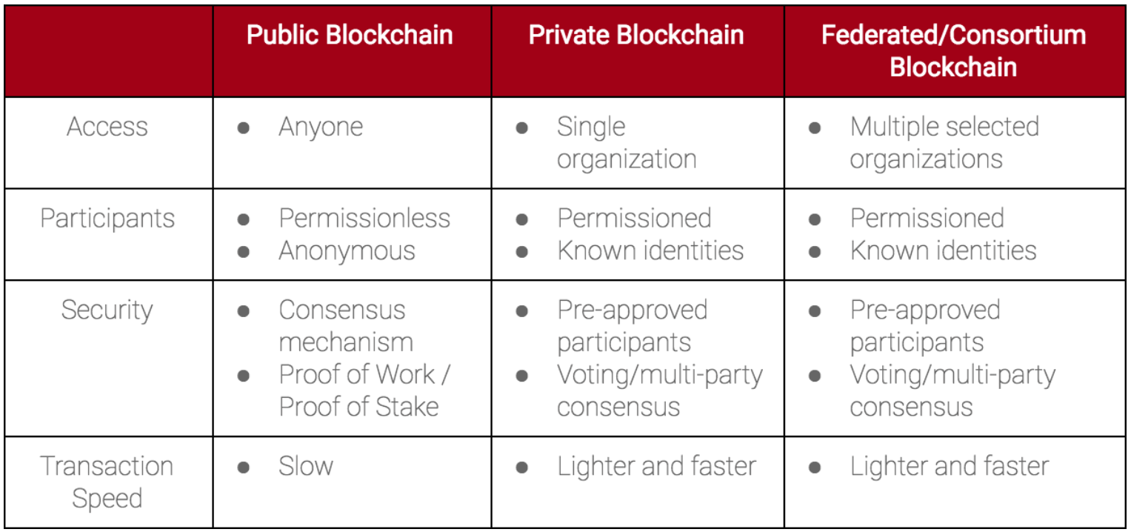
Network Types
SOFTWARE QUALITY CONFERENCE
PACIFIC NW
Public – Permissionless
Cryptocurrencies are usually public
Private - Permissioned
A large bank may have a specific division that needs immutability of records
Hybrid - Permissioned
Internal is centralized and external is decentralized
PNSQC ™

Slide 13
The “Trilemma”
SOFTWARE QUALITY CONFERENCE
PACIFIC NW
Blockchain networks are constrained by three main properties:
Decentralization - how many entities are used for consensus and hold a copy of the blockchain
Scalability - how many devices are in the network
Security – how much trust is to be provided by the technology
Decentralization
Scalability
Security
PNSQC ™
Notes:
In general, all blockchain systems are constrained by three main properties: (a) decentralization, (b) scalability and (c) security. This is referred to as the “trilemma” of elements that need to be balanced to ensure an optimum design is employed for its intended purpose.

Slide 14
The “Trilemma” cont’d
SOFTWARE QUALITY CONFERENCE
PACIFIC NW
These properties are adjusted to meet specific network designs needs
Examples:
Need for Speed – to increase transaction speed more centralization may be tolerated
Need for Scale – to achieve a very large scale:
more centralization can used and/or
security is offloaded to proprietary approaches or
trust may be shifted to entities by traditional means
Budget – to achieve cost reduction, nodes might be scaled back which also can affect security
PNSQC ™

Slide 15
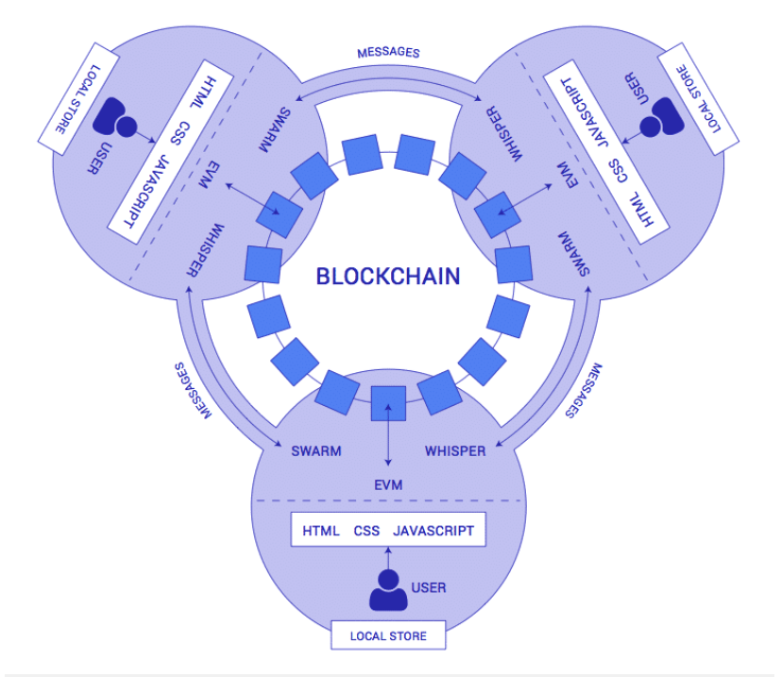
Applications
SOFTWARE QUALITY CONFERENCE
PACIFIC NW
Centralized – legacy
Oracles (connectors) can provide a method for legacy applications to quickly connect to the blockchain
Some vendors are embedding blockchain as part of key system modules, e.g., SAP’s Leonardo technologies
Decentralized Applications (Dapps)
DApps can communicate with the underlying blockchain, e.g., chaincode
They are also the bridge between external sensors or events to manage the state of network actors and contracts
PNSQC ™

Slide 16
Applications Based on Blockchain and Dapps
SOFTWARE QUALITY CONFERENCE
PACIFIC NW
Four Chinese entities - Xiamen, Innov, Corelink, and VeChain
Integrating multiple stages of supply chains into a unified solution
Track physical assets and inventories in real-time
Integration of DApp, blockchain, IoT (RFID), artificial intelligence and cloud technologies in the solution
Two consortiums - Vakt and Komgo
Building a commodity exchange and settlement platform for oil companies, trading firms, banks and goods inspection companies.
Vakt will handle the contract and terms processing
Komogo will act as the financial settlement arm of the exchange.
PNSQC ™
Notes:
For example, a participating manufacturing company would utilize a DApp to order, pay and monitor a shipment of raw material to a factory.
If the shipment was delayed, it would be detected by the RFID component of the system, which would relay the information to the chaincode and ultimately the DApp.
Using Artificial Intelligence, the DApp may determine the delay is out of acceptable limits for the factory and initiate an order on a commodity exchange for new material from another vendor.
The new supplier agrees to fulfill the order and the contract would be recorded in the blockchain. Once the new material is received and verified by the factory, the DApp then communicates this information to the chaincode, which releases payment to the supplier via the same blockchain network. In this case, numerous emails, telephone communications and intermediaries are replaced by a highly integrated network.

Slide 17
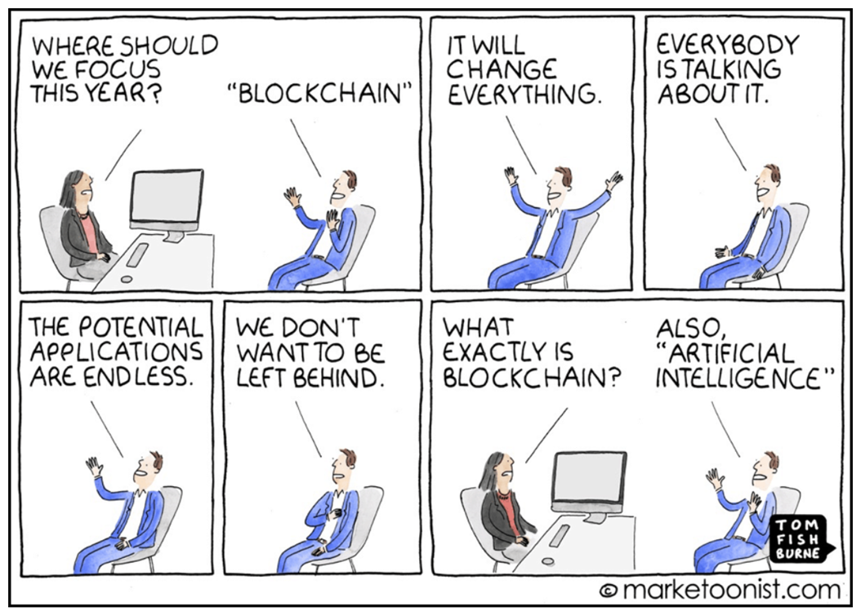
When does blockchain makes sense?
SOFTWARE QUALITY CONFERENCE
PACIFIC NW
When to consider using blockchain
No single authority writes the data to the blockchain
Immutability of the data is necessary
A high degree of data security and redundancy is needed
All participants have the same incentives to participate
All participants require data transparency
The transaction speed is not a paramount concern
PNSQC ™

Slide 18
Is Blockchain Ready for Prime Time?
Technology Adoption Lifecycle five consumer phases
Currently – my assessment – blockchain is in the innovator stage
Innovators seek out novel technologies and are often in hypercompetitive markets
Standards are immature and risk is high
This phase is marked by initial demo’s, trials, limited deployments, whitepapers, lessons learned articles, etc.
Source: Crossing the Chasm [Geoffrey Moore]

Slide 19
Testing Alignment to the Tech Adoption Lifecycle
SOFTWARE QUALITY CONFERENCE
PACIFIC NW
Innovator Phase:
Testers:
Need to be able move across many domains and at a deep level
Need programming skills, have a sound understanding of system engineering
Opportunities - product manufacturers
Risk – no guarantee that technology will take off
Testing Considerations:
Everything is new, there is no playbook
Reliance on the fundamentals - PDCA
Tools:
Testing tools at this stage are usually “home-grown”, minimal and not deployed for commercial use.
PNSQC ™

Slide 20
Testing Alignment to the Tech Adoption Lifecycle
SOFTWARE QUALITY CONFERENCE
PACIFIC NW
Early Adopter Phase:
Testers:
Segment specialization begins to occur
Need a broad and deep understanding of the segment
Opportunities - product manufacturers and large integrators
Risk is reduced as real, cost effective existence proofs are made widely available
Testing Considerations:
Basic published standards will be available
Formal system testing will be a joint effort in consortium or multiagency testbeds – high deg of coordination.
Could see walled off systems
Deployments explore the trials and limits of the Trilemma – painful experiences
Tools:
Auditing tools will be the first standard tools to emerge
Vendors will provide a standard set of basic monitoring tools with their products.
PNSQC ™

Slide 21
Testing Alignment to the Tech Adoption Lifecycle
SOFTWARE QUALITY CONFERENCE
PACIFIC NW
Early Majority Phase – chasm is crossed
Testers:
Segment specialization is still dominate
Opportunities move down market to large, more conservative organizations
Risks are greatly reduced
Testing Considerations:
Trilemma best practices will emerge
External blockchain will be more deeply integrated with internal systems
Tools:
Independent tool providers and opensource testing frameworks will emerge
Auditing tools will be part of the Devops process
PNSQC ™

Slide 22
What next?
SOFTWARE QUALITY CONFERENCE
PACIFIC NW
PNSQC ™

Slide 23
Thank You! John Cvetko TEK Associates john.cvetko@tekasc.com 503 799 2242

